Slide 1
Decision Tree Classifiers
Random Forest, AdaBoost, Gradient Boosted

Slide 2
Methods
Random Forest (“Trees”)
Ensemble of trees
No bagging (sparse positive class)
160 trees, depth of 10
AdaBoosted (“Ada”)
Adaptively grows each weak tree to correct previous tree’s errors
Uses weighted average of weak trees to predict
Gradient Boosted (“Boosted”)
More generalized boosting approach
Adaptively grows each weak tree to correct previous tree’s errors
Uses approximation of loss function to enable gradient descent

Slide 3
Evaluation
Average AUC of ROC curves was calculated
Histogram of AUC of ROC curves
AUC vs support
Precision-Recall curves
F1-score vs support

Slide 4
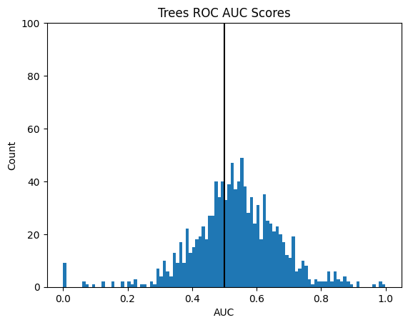
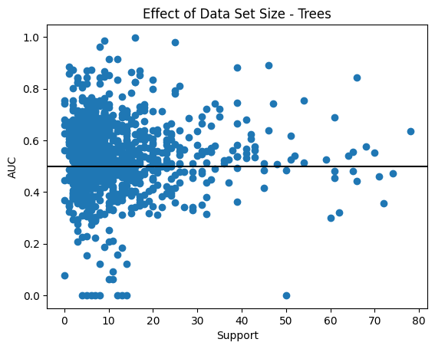
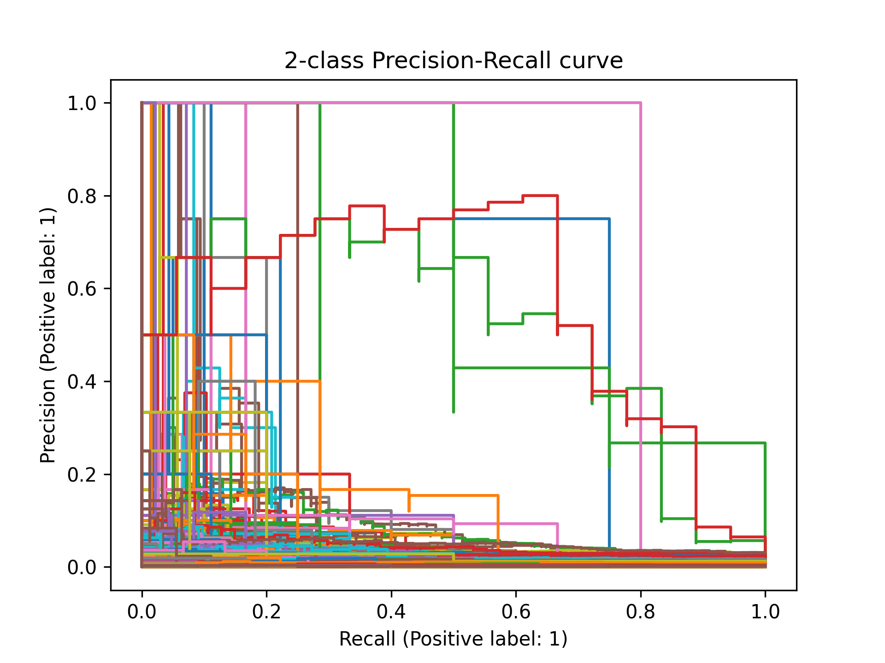
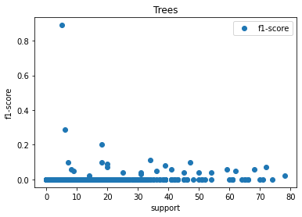
Random
Forest
AUC:
0.536

Slide 5
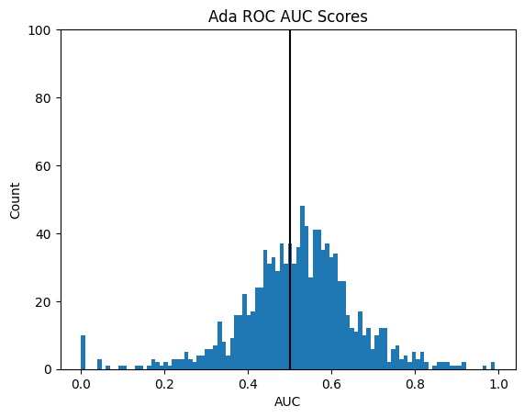
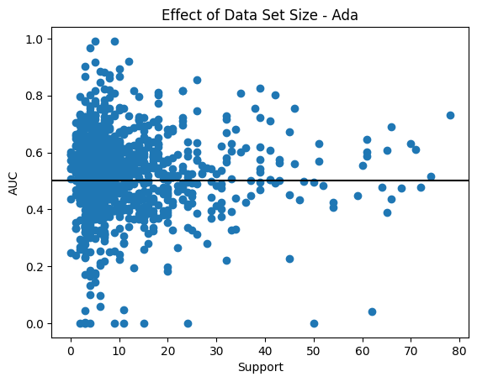
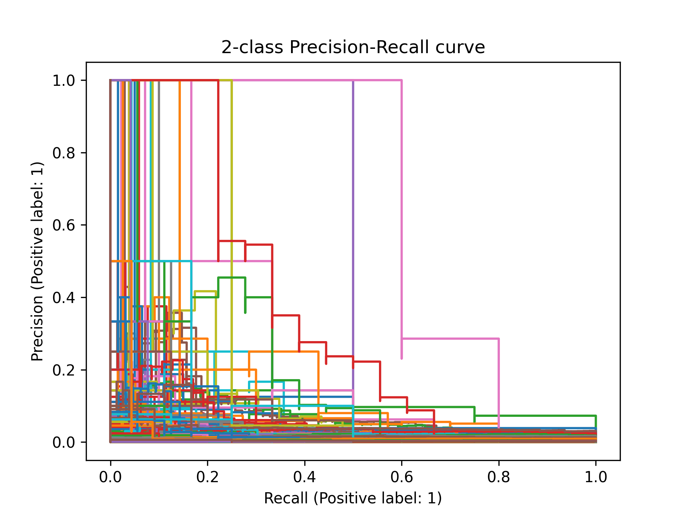
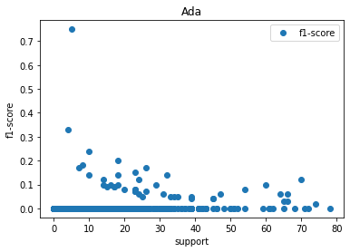
AdaBoost
AUC:
0.520

Slide 6
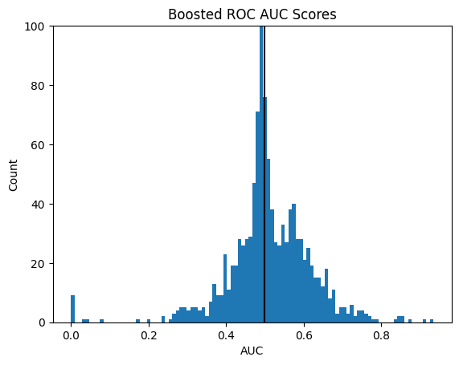
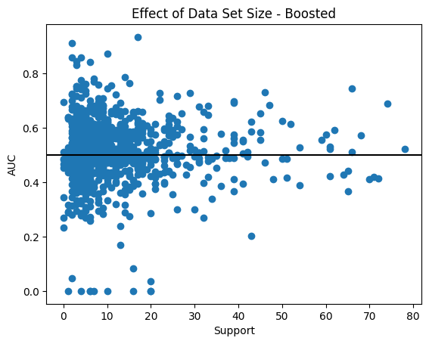
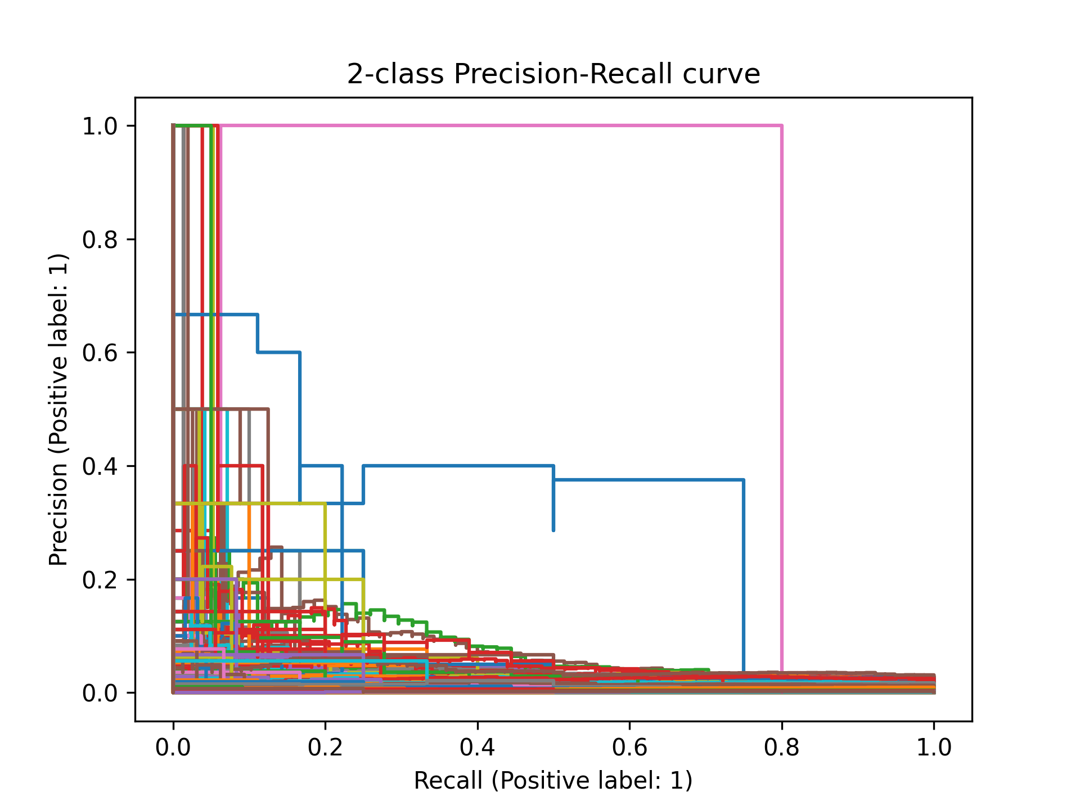
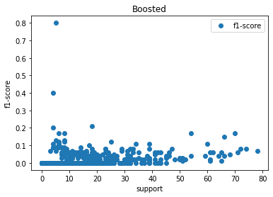
Gradient
Boosted
AUC:
0.511

Slide 7
Conclusion
Gradient Boosted showed the lowest average AUC but the best F1-score trend
The best predicted GO terms were associated with respiratory processes
Mitochondrial functions
Electron transport chain
Glycolysis
Determining minimum support needed for effective prediction could help guide data collection efforts

